Slide 1
KeyStone II ARM Cortex A-15 CorePac Overview
MCP-MGM Applications Team
December 2012

Slide 2
Agenda
ARM CorePac in KeyStone II
ARM Cortex A-15 Features
Interface to the SOC and Coherency Issues
Benchmarks
Interrupt Controller
Power Management
Debug and Trace

Slide 3
ARM CorePac in KeyStone II
ARM CorePac in KeyStone II
ARM Cortex A-15 Features
Interface to the SOC and Coherency Issues
Benchmarks
Interrupt Controller
Power Management
Debug and Trace

Slide 4
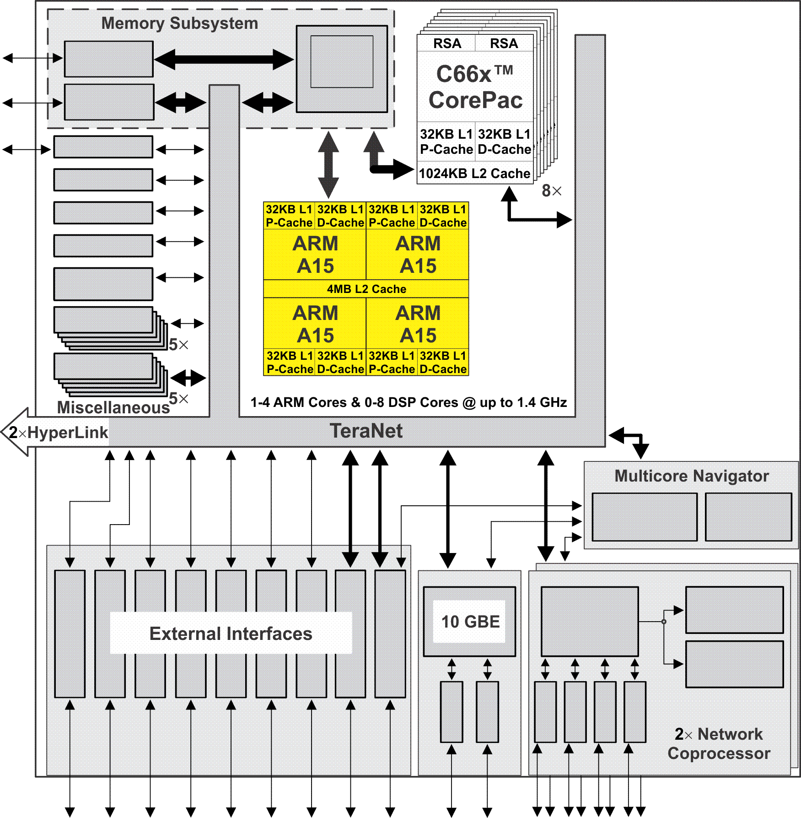
KeyStone II and ARM CorePac
Single, Dual, or Quad-ARM Cortex A15 CorePac operating at up to 1.4 GHz.
L1 Memory: 32KB L1 Data cache 32KB L1 Program Cache
L2 Memory: 4 MB L2 Cache is shared between the 1 to 4 ARM A-15 core(s)
AMBA 4.0 AXI Coherency Extension (ACE) master port
Module interrupt controller
Cluster-level and core-level power management and low-power standby modes
Advance debug features
Notes:
4
Contains an ARM cluster with one, two or 4 ARMs in it.
Running at 1.4GHz.
Two levels of memory just like DSP.
But L2 is shared for cache coherency.
Connected to the MSMC through ACE also provided cache coherency with other peripheral masters.
Power management.(Wait for Interrupt/ Wait for Event).
BootROM.

Slide 5
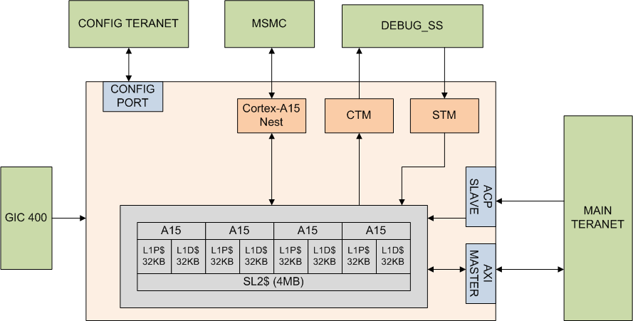
ARM CorePac Functional Block Diagram
Notes:
CTM – Cross Trigger matrix
STM – System Trace Microcell
ACP – Accelerated coherency port
Next – Asynchronous interface to MSMC
AXI – is really via the MSMC

Slide 6
ARM Cortex A-15 Features: ARM Core
ARM CorePac in KeyStone II
ARM Cortex A-15 Features
ARM Core
NEON
VFP
MMU
Interface to the SOC and Coherency Issues
Benchmarks
Interrupt Controller
Power Management
Debug and Trace

Slide 7
Cortex A-15 Features – The Core (1/2)
Superscalar architecture
2 ALU, 2 shifts, branch unit, multiply and divide, load store
3 concurrent dispatched, up to 8 concurrent issues
Full implementation of ARMv7-A architecture instruction set
More MAC instructions (normalization and rounding)
Integer divide
Automatic thumb mode (16-bit instructions)
Pipeline optimization
Deeper pipeline 13 stages to issue (2 integer, 4 multiply and load, more for NEON and FPU(2-10))
Out-of-order pipeline (3-12 stages) execution

Slide 8
Cortex A-15 Features – The Core (2/2)
Dynamic branch prediction – Loop prediction and indirect branch predictor
Branch Target Buffer (BTB)
Global History Buffer (GHB) has three arrays:
Taken array
Not taken array
Selector array
Sophisticated hardware algorithm makes the prediction

Slide 9
Cortex A-15 Features – Fetch & Memory
Increase fetch from 64 to 128 bits
Full support for unaligned fetch address
L1D and L1P
32KB size
Configured as cache
L2 is unified memory that serves ALL cores in the cluster:
4MB size
Configured as cache

Slide 10
ARM Cortex A-15 Features: NEON
ARM CorePac in KeyStone II
ARM Cortex A-15 Features
ARM Core
NEON
VFP
MMU
Interface to the SOC and Coherency Issues
Benchmarks
Interrupt Controller
Power Management
Debug and Trace

Slide 11
SIMD Engine NEON
64/128-bit data instructions
Fully integrated into the main pipeline
32x 64-bit registers that can be arranged as 128-bit registers
Data can be interpreted as follows:
Byte
Half-word (16-bit)
Word
Long

Slide 12
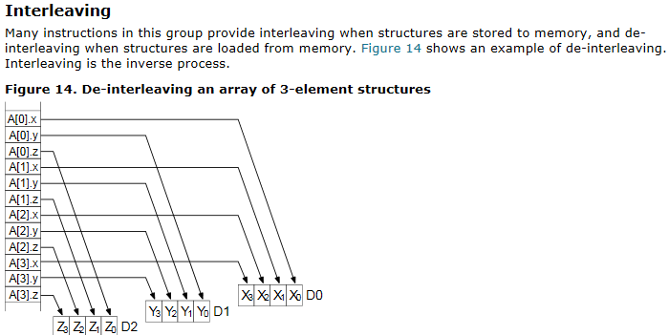
NEON Registers
Load and store data into 64-bits registers from memory with on the fly interleave – from ARM documentation:

Slide 13
ARM Cortex A-15 Features: VFP
ARM CorePac in KeyStone II
ARM Cortex A-15 Features
ARM Core
NEON
VFP
MMU
Interface to the SOC and Coherency Issues
Benchmarks
Interrupt Controller
Power Management
Debug and Trace

Slide 14
Vector Floating Point (VFP)
Fully integrated into the main pipeline
32 DP registers for FP operations
Native (Hardware) support for all IEEE-defined floating-point operations and rounding modes; single and double precision
Supports fused MAC operation (e.g., rounding after the addition or after the multiplication)
Supports half-precision (IEEE754-2008) (1 sign, 5 exponent, 10 mantissa)

Slide 15
ARM Cortex A-15 Features: MMU
ARM CorePac in KeyStone II
ARM Cortex A-15 Features
ARM Core
NEON
VFP
MMU
Interface to the SOC and Coherency Issues
Benchmarks
Interrupt Controller
Power Management
Debug and Trace

Slide 16
Memory Management Unit (MMU)
Logical-to-physical memory translation
Users protection
Hardware manages the actual memory
Large physical addressing, 40-bit (1TB)
Three-level data structure to get to 4kB page at each stage
Two levels to get to 2MB pages (Linux huge pages)
Translation Lookaside Buffers (TLB) cache one page of address translations per entry to speed up translation process

Slide 17
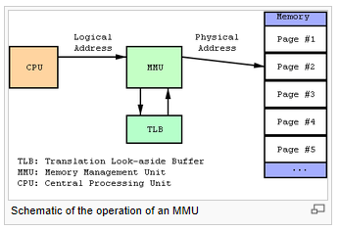
From Wikipedia – MMU, TLB and Page

Slide 18
Memory Management Unit (MMU)
To support multiple operating systems (adding a Guest operating system):
Three privilege layers
User Mode is for “Guest” (application)
Supervisor controls multiple guests
Hypervisor controls the complete system
Two-stage translation
From logical to intermediate physical address for supervisor for each operating system
From intermediate to real address for hypervisor for the complete system

Slide 19
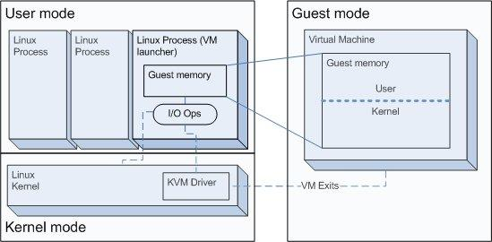
Two Stage MMU – Guest to Supervisor

Slide 20
Two Stage MMU Guest to Supervisor, Supervisor to Hypervisor

Slide 21
Interface to the SOC and Coherency Issues
ARM CorePac in KeyStone II
ARM Cortex A-15 Features
Interface to the SOC and Coherency Issues
Benchmarks
Interrupt Controller
Power Management
Debug and Trace

Slide 22
ARM Cluster Buses AMBA – Advance Microcontroller Bus Architecture
AXI (AMBA Advanced eXtensible Interface) connects the ARM cluster with MSMC module using the AXI-VBUS master.
APB (AMBA Advanced Peripheral Bus) provides access to peripherals and internal memories.
ATB (AMBA Trace Bus) supports the trace features for the ARM cluster.

Slide 23
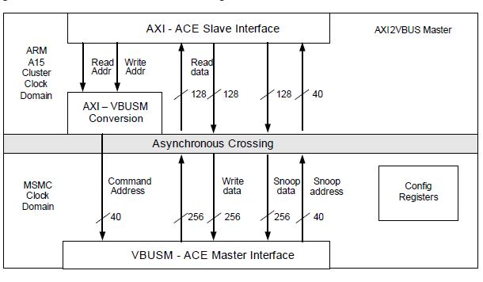
ARM AXI-VBUSM Interfaces to the MSMC

Slide 24
ARM AXI-VBUSM Interfaces to the MSMC
40-bit address access to external memory (8G DDRA, 2G DDRB)
Snooping mechanism maintains coherency between L2 cache and DDRA and MSM memory
Access to all SOC internal memory via TeraNet
ARM cluster PrivID for the TeraNet is 8

Slide 25
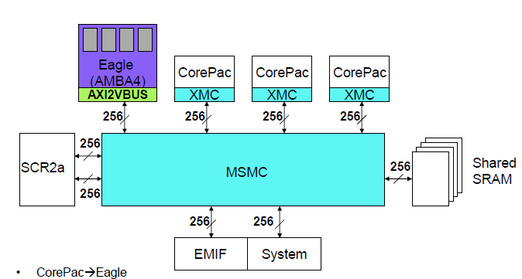
KeyStone II: IO Cache Coherency
ARM
A15
Write-invalidate
Read-snoop for MSMC SRAM
TeraNet
Write-invalidate
Read-snoop for
DDR3A
IO coherency for the ARM, SMP for the quad cluster:
DDR3A from 0x08_0000_0000 to 0x09_FFFF_FFFF (8 G)
MSMC SRAM
Coherency for ease of use and performance
Notes:
One still needs to do ensure consistency, with load and store exclusive instructions and data barriers (DMB); SIMPLIFY?

Slide 26
ARM CorePac: Cache and Coherency
L1 to L2 cache coherency based on SCU (Snoop Control Unit) algorithm.
Unified L2 Cache coherency for external (to the CorePac) memory and IO; Based on snooping cache coherency protocol.
Between ARM cache and DDR3A
Between ARM cache and MSMC SRAM (on-chip scratch memory)
No IO or DDRB coherency supported by the hardware.
Notes:
Include memory portion of KII diagram

Slide 27
Error Correction and Latency
32KB L1 cache program, 32KB L1 cache data
Large L2 cache (4MB, 16-way set associative)
1MB, 16-way set associative in some variants
Internal and external memory Error Correction Code (ECC)
1 bit error correct, 2 bits error detect
L1 hit – 4 cycles latency (4 stage load pipeline, can be hidden)
L1 miss, L2 hit – 20 cycles (4MB) or less (16 cycles 1MB)
L2 miss MSMC SRAM - ~50 cycles
L2 miss DDRA memory ~100ns (~140 cycles) if DDR page is open

Slide 28
Reliability
The KeyStone II ARM A15 CorePac is designed for high-reliability embedded applications; 100k power-on hours at 105C.

Slide 29
Benchmarks
ARM CorePac in KeyStone II
ARM Cortex A-15 Features
Interface to the SOC and Coherency Issues
Benchmarks
Interrupt Controller
Power Management
Debug and Trace

Slide 30
Benchmarks Overview
Dhrystone, DMIPS/MHz, CPU core and L1 only:
3.5 DMIPS/MHz (highly dependant on compiler)
19600 DMIPS with KeyStone II Quad-ARM CorePac at 1.4GHz
Floating point:
Quad single-precision IEEE-754 FMAC per cycle
Notes:
Dhrystone score of 3.5DMIPS/MHz requires right version of compiler (ARM RVCT or GCC 4.8.0) that uses NEON SIMD instructions for loads and stores, measures core and L1D only. Benchmark confirms the 3-issue performance.
Floating point is 4 operations per cycle. An operation is add, multiply, multiply and accumulate, etc. In a typical application loads and stores will reduce the sustained operations to 50% or less.

Slide 31
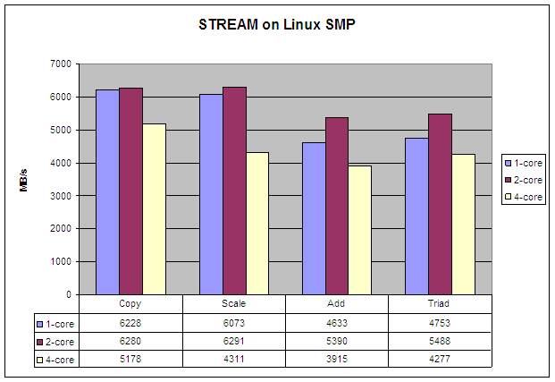
Memory Bandwidth Benchmarks
The STREAM benchmark is the de facto industry standard benchmark for the measurements of computer memory bandwidth.
DDR3-1600 theoretical throughput is 12.8 GB/s
~30% to ~50% achieved
Physical placement of arrays is critical; Linux virtual memory with 4kB pages is good.
Memory bandwidth, external memory only:
Stream Copy a(i) = b(i), where a and a b are arrays.
Stream Scale a(i) = q * b(i), where a and b are arrays, and q is a constant.
Stream Add computes a(i) = b(i) + c(i), where a, b, and c are arrays.
Stream Triad computes a(i) = b(i) + q * c(i), where a, b, and c are arrays, and q is a constant.
Array sizes are defined to force missing on cache regardless of size
Notes:
Stream is defined to use data arrays sized larger than SoC caches so the benefit of large L2 is ignored. Stream exercises the number of outstanding loads and stores, and the write through (or streaming) mode of the L2 cache.
The formula to calculate external memory bandwidth accounts for read and write in copy and scale, and two reads and write in add and triad. The extra read that a write-allocate cache needs is not included in the formula, and turning of the streaming/write-through will significantly drop the results. But code like this is why the streaming mode is there.
Memory location of arrays is critical, maximum number of open DDR pages (sized 8kB) per DDR rank required. Linux page tables with 4kB pages with normal setup results in linear virtual memory being pseudorandom in physical space is close to optimal for stream.

Slide 32
Interrupt Controller
ARM CorePac in KeyStone II
ARM Cortex A-15 Features
Interface to the SOC and Coherency Issues
Benchmarks
Interrupt Controller
Power Management
Debug and Trace

Slide 33
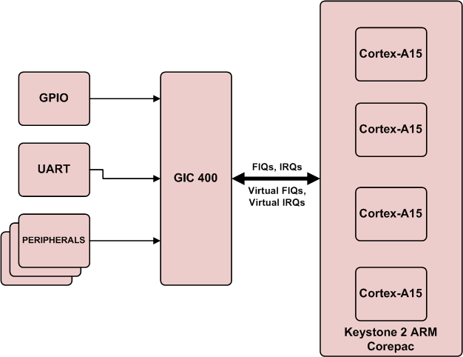
GIC-400 (ARM Generic Interrupt Controller)
Event sources:
Various IP and peripherals
Software generated (SGI ) by ARM core
Signal over the AXI interface
Virtual and physical interrupts

Slide 34
GIC-400 Interrupt Controller
The ARM Generic Interrupt Controller, a.k.a. the GIC-400, is a high-performance, area-optimized interrupt controller with an Advanced Microcontroller Bus Architecture (AMBA) Advanced eXtensible Interface (AXI) interface.
The GIC-400 implements:
16 Software Generated Interrupts (SGIs)
6 external Private Peripheral Interrupts (PPIs) for each processor
1 internal PPI for each processor
A configurable number of Shared Peripheral Interrupt (SPIs)
The GIC-400 asserts the following signals to indicate pending interrupts:
Physical interrupts:
nFIQCPU[NUM_CPUS–1:0]
nIRQCPU[NUM_CPUS–1:0].
Virtual interrupts,
nVFIQCPU[NUM_CPUS–1:0]
nVIRQCPU[NUM_CPUS–1:0].

Slide 35
GIC400 in KeyStone II
The following figure gives an overview of the GIC-400 in KeyStone II devices. It shows the interrupts that are sent to the GIC-400 from various sources and the key phases of interrupt-related signaling in the SoC.

Slide 36
Power Management
ARM CorePac in KeyStone II
ARM Cortex A-15 Features
Interface to the SOC and Coherency Issues
Benchmarks
Interrupt Controller
Power Management
Debug and Trace

Slide 37
Advanced Power Management
Multiple power domains inside the ARM CorePac
Extremely fast state save and restore speeds up hibernation
Fine-grain pipeline shutdown using 32-entry loop buffer disables fetch and some decode pipeline stages.

Slide 38
Energy Efficiency
Clock gating inside the ARM CorePac:
Total dynamic power consumption for a fully-loaded 1.4GHz core will range from 1.2W to 0.35W depending on the type of instructions it runs.
Wait for interrupt and event (WFI, WFE) instructions bring the dynamic power down to <0.1W per core.
Power switches per core and per CorePac including L2:
Each ARM A15 core can be shut down independently.
The entire ARM A15 CorePac, including the 4MB/1MB L2 cache, can also be shut down.
Reduces static power to <5%
Notes:
Depending on the transistor temperature, static power (leakage) is ½ to 2/3 of total power. Dynamic power scales with clock speed, static does not.

Slide 39
Debug and Trace
ARM CorePac in KeyStone II
ARM Cortex A-15 Features
Interface to the SOC and Coherency Issues
Benchmark
Interrupt Controller
Power Management
Debug and Trace

Slide 40
Debug and Trace Options
Lab-based debug; CCSv5 gives full support
Trace and Run-Time debug

Slide 41
Lab-Based Debug
CCSv5 works with the ARM cores.
The ARM integrated development environment, RealView Development Suite (RDS), provides lab-based debug facilities (breakpoint, memory view, etc.).
GNU Debugger (GDB)

Slide 42
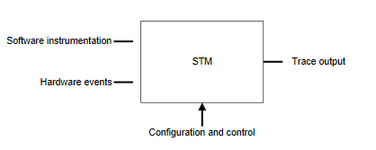
Trace Facilities
System Trace Macrocell (STM) enables tracing of system activities from multiple sources; either hardware events or software instrumentation.
Coresight is a set of hardware and software architecture specification documents that enables easy development of on-chip trace and debug.

Slide 43
STM Challenges
Facilities for collecting trace data:
Triggering
Filtering
Cross triggering:
Cross Trigger Interface (CTI)
Cross Trigger Matrix (CTM)
Options for storing and delivering trace data to host:
Export using trace port and trace port analyzer (TPA) to capture the trace information
Write the trace to the Embedded Trace Buffer (ETB) and read it using JTAG or post-mortem memory read

Slide 44
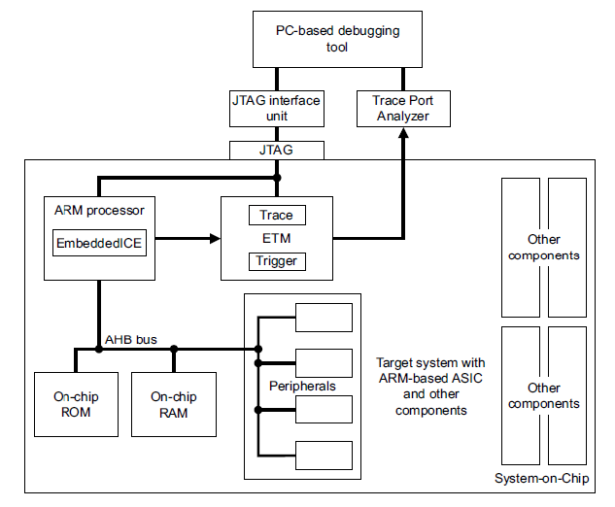
STM as Part of the SoC

Slide 45
Tracing Features
Packetized trace, real-time asynchronous trace export
Multicore trace using single capture unit
Coresight components include:
PTM (Program Flow Trace)
ADI (Arm Debug Interface)
HTM (AHB Trace Macrocell) bus trace
ITM (Instrumentation Trace Macrocell) (printf)
DWT (Data Watch Trace)
Trace Funnel combines multiple trace streams

Slide 46
Embedded Cross Trigger (ECT) Module
CTI controls the trigger interface
Combines and maps triggering requests
Broadcasts trigger requests to all other interfaces on the SOC
CTM controls the distribution of events
Enables multiple ECTs be connected to each other (channel interface)
Notes:
ECT - Embedded Cross Triggering

Slide 47
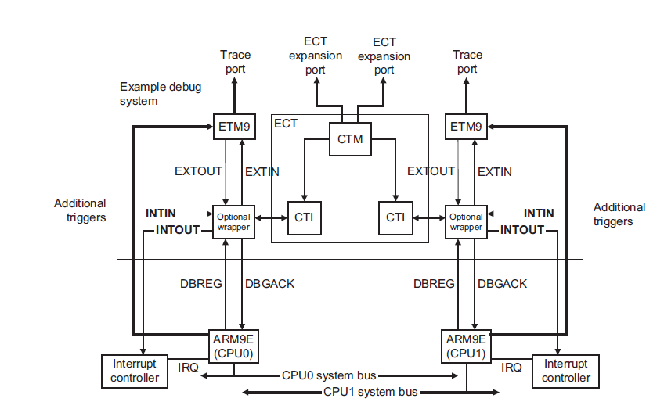
Cross Triggering – 2 CTIs & the CTM

Slide 48
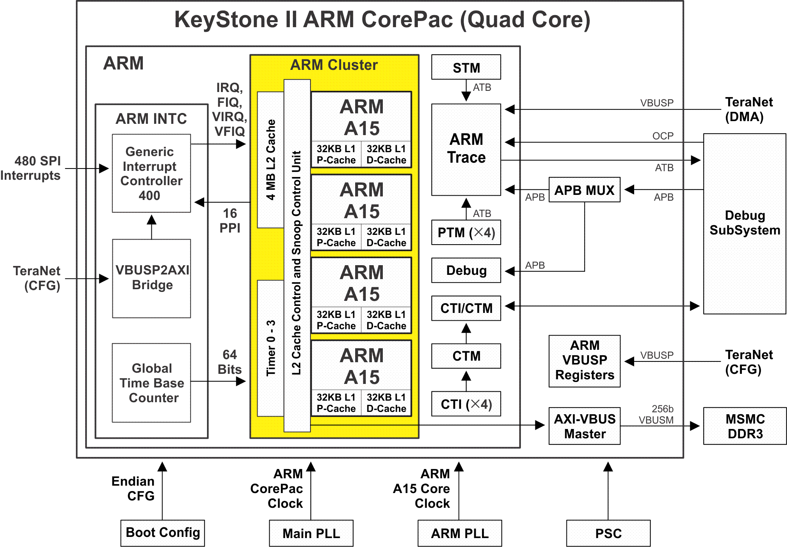
Summary - Quad Cortex-A15
ARM Cortex-A15 MPCore
ARM GIC-400 interrupt controller
Access to and from the SoC
Notes:
Yellow area is the standard quad A15 MPCore with 4MB of shared coherent cache, each core is in its own power switched domain and the MPCore with L2 cache is in a further power switched domain
GIC-400 is the standard interrupt controller from ARM
The path the cores and caches do memory reads and writes goes through Eagles Nest to MSMC. Snooping by MSMC use this path as well
The rest of the interfaces are related to clocking, debugging, tracing, and production testing.

Slide 49
For More Information
ARM Reference Manuals http://infocenter.arm.com/help/index.jsp
A15 Technical Reference Manual (TRM) r2p2
GIC-400 r0p0rel1
STREAM Benchmark http://www.cs.virginia.edu/stream/
For questions regarding topics covered in this training, visit the support forums at the TI E2E Community website.

